Slide 1
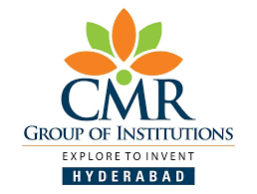
CMR COLLEGE OF ENGINEERING & TECHNOLOGY
Kandlakoya, Medchal, Hyderabad - 501401
Department of Computer Science and Engineering
Telangana Tourist Guide
Under esteemed guidance of
Guide Name
Ranjith
Assistant Professor
Name of the students
20H51A0513-K.Nithin
20H51A0510-G.Praneeth
20H51A0522-P.Tharun

Slide 2
Outline
Abstract
Introduction
Literature survey
Existing system
Research Objective of Presentation
Problem Definition
Proposed system architecture
Proposed Methods
Performance Measure
Result Analysis
Conclusion
References
Notes:
Abstract
Introduction
Literature survey
Exis system
Research Objective of Presentation
Problem Definition
Research work
- Proposed system architecture
Performance Measure
Results
Conclusion
Future Work
2

Slide 3
Abstract
The ultimate goal of the App is to explore the requirements of travelers in Telangana and our proposed and developed solution of android application including some basic guidance for the travelers in Telangana. Every year thousands of foreigners from diverse countries come to visit Telangana for different purposes. Most of them come for religious, study, and business purposes. Besides, tourists also visit different places of natural beauty and history of the country. However, being foreigners, the travelers face different types of problems including limited transportation information, problems in locating nearby hotels and so on.
Notes:
3

Slide 4
Based on travelers’ requirements, we have come up with our online mobile application which can solve their problem during visiting Hyderabad city of Telangana. The App illustrates the features, development method, result, and uses of our android application named “Tourist Guide”

Slide 5
INTRODUCTION
Besides, tourists also visit different places of natural beauty and history of the country. However, being foreigners, the travelers face different types of problems including limited transportation information, problems in locating nearby hotels and so on. Based on travelers’ requirements, we have come up with our online mobile application which can solve their problem during visiting Hyderabad city of Telangana. The App illustrates the features, development method, result, and uses of our android application named “Tourist Guide
Notes:
5

Slide 6
Literature Survey
This research makes important contributions to the tourism management literature in various ways. The first contribution is the testing of the mediation effects of online tourists’ satisfaction on the relations (a) between online destination image and the motivation to visit (b) between online word of mouth and motivation to visit (c) between online vulnerability security and motivation to visit. Based on the theory of attitude or planned behavior in relations to conceptual research model and variables by Richard P.Bagozzi (1992) was used as a base to reach the inference that online destination image with credible reputation attracts and largely impact online tourists’ satisfaction hence motivation to visit.
Notes:
6

Slide 7
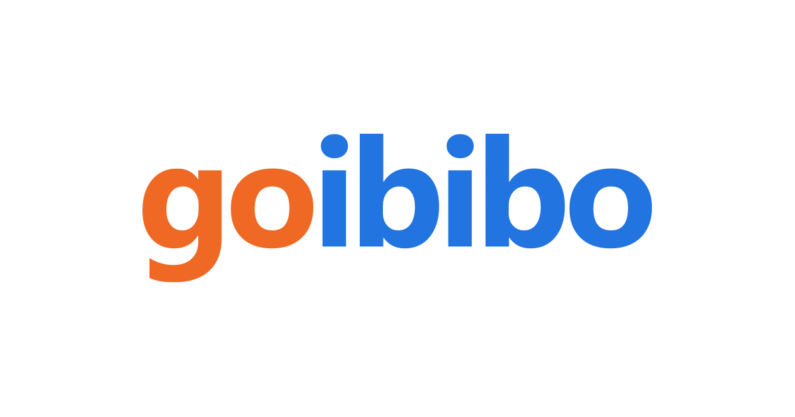

Existing system
providing range of choice for hotels
Trusted source for finding a great restaurant
Notes:
7

Slide 8
Research Objective
The aim of the project has been to develop an essential app for the tourists. The vision of our app is to help the travelers by increasing their efficiency to navigate around new places. The app also provides a few photos to offer a better experience. It also has an amazing feature which provides location based information like maps after reaching the desired destination, a user generally looking for a hotel, café or nearby place for relaxation.
Notes:
8

Slide 9
Research objective
Easy to design
Higher demand compared to the existing solutions
Performs good
Easy access
Low cost

Slide 10
Problem Definition
The purpose of app is established fact that internet users are increasing today. One of the main purpose of the app is to facilitate the offline customers online because customers cannot spend their precious time in searching for the tourist spot.
Telangana is a state where in a short time, you can explore different kind of tourist spots and enjoy a lot. The problem is that we although have many different websites and agencies that offer different kind of services.
But there is a lack of communication between the travel agency and the tourists and hence we have developed this app so that the tourists can enjoy on their own without any third-party.
Notes:
10

Slide 11
Proposed system architecture
HOME
-Welcome
-Jump to next place
TOURIST PLACES
-Select a place
Basara
Golconda
Medak church
1-History of the place
2-Architecture of the place
3-Near by must visit places
4-Near by hotels and restaurants
5-Direction to the nearby by places.

Slide 12
Proposed Methods
Android Studio is the official integrated development environment (IDE) for Android application development. It is based on the IntelliJ IDEA, a Java integrated development environment for software, and incorporates its code editing and developer tools.
A content provider presents data to external applications as one or more tables that are similar to the tables found in a relational database. A row represents an instance of some type of data the provider collects, and each column in the row represents an individual piece of data collected for an instance.
Synchronizing application data with your server using an implementation of AbstractThreadedSyncAdapter.
Loading data in your UI using a Cursor Loader.
Relationship between content provider and other components.

Slide 13
Performance Measure:
The mobile-app experience differs from its desktop counterpart in that a user's interaction with the app doesn't always begin in the same place. Instead, the user journey often begins non-deterministically. For instance, if you open an email app from your home screen, you might see a list of emails. By contrast, if you are using a social media app that then launches your email app, you might go directly to the email app's screen for composing an email.
The API you use to retrieve data from a content provider.
The API you use to insert, update, or delete data in a content provider.
Other API features that facilitate working with providers.

Slide 14
Result Analysis
Registered user gets the recommendation of the places of their preferences.
•They can find the places using this system.
•User can easily view the place on map with its description, image and address.
•The system also provides food places in the application
•System GUI is easy to use.
•The system in robust and secure in nature.
It is essential as it allows users to know their current location and discover various nearby locations. The basic objective of e-Tourist Guide app is to provide various services to tourist so that he/she can feel at home during the stay at hotels

Slide 15
Conclusion
Keeping travelers‟ need in consideration and the current trend to the use of android devices, we have developed our Travel Guide Android Application. The application is able to meet most of the requirements that are commonly asked by travelers, Besides, the simplicity of using the application has been maintained. The app can be helpful for Telangana people who are newcomers to Hyderabad city.

Slide 16
References
https://www.tripadvisor.in/
https://www.holidify.com/state/telangana/top-destinations-places-to-visit.html
https://www.telanganatourism.gov.in/
https://www.trawell.in/telangana

Slide 17
Thank You!

